Slide 1
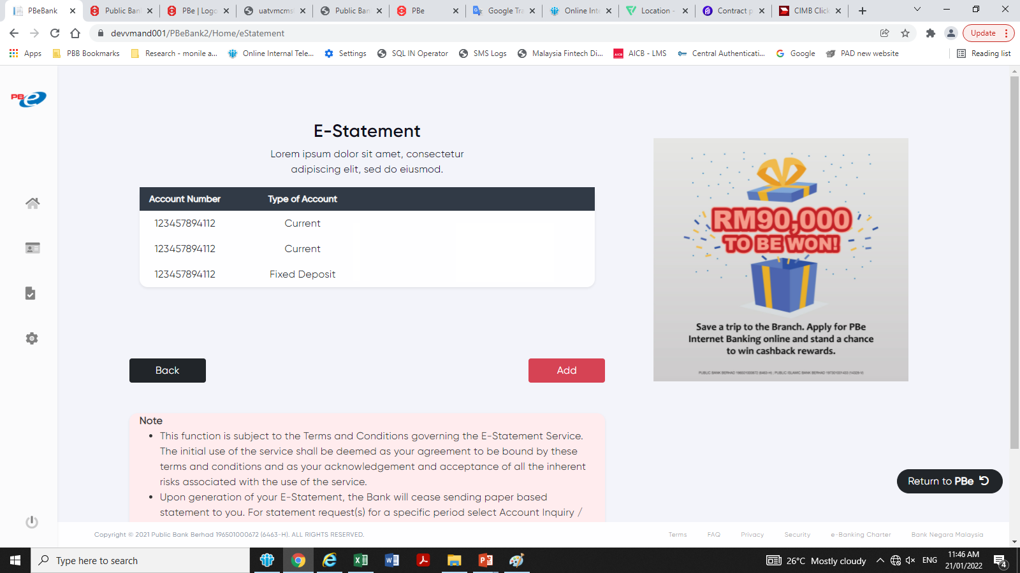
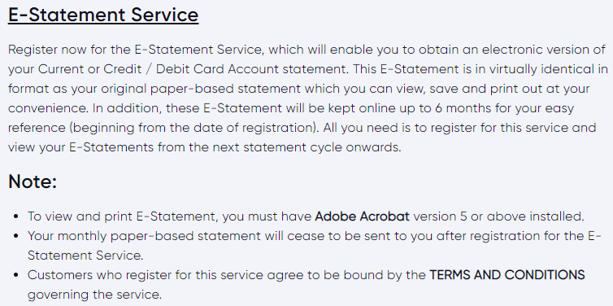
List down all the accounts/cards that linked to the PBe profile.
Register / Deregister E-Statement
This is a slider where user can tab on it to register/deregister eStatement. When the screen is loaded, it will be defaulted to the existing selection.
Account No.
E-Statement Registration Status
Register E-Statement
Deregister E-Statement
Deregister E-Statement
To add in the additional notes for eStmt Registration.
Next

Slide 2
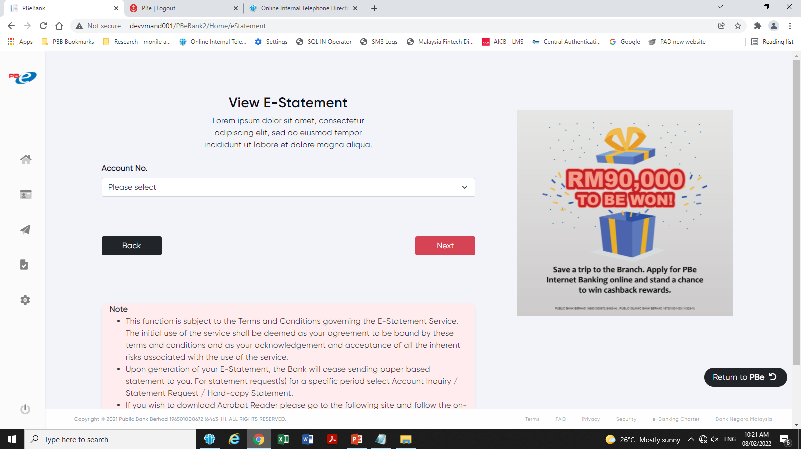
Add Clear button

Slide 3
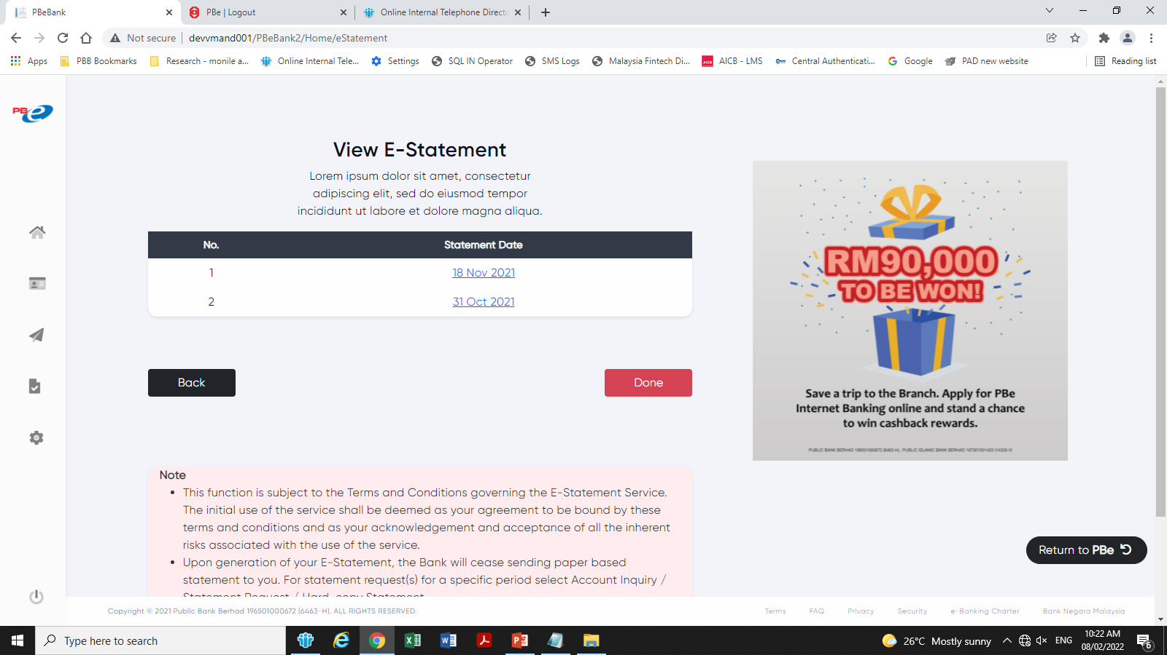
Should route to Statement home screen

Slide 4
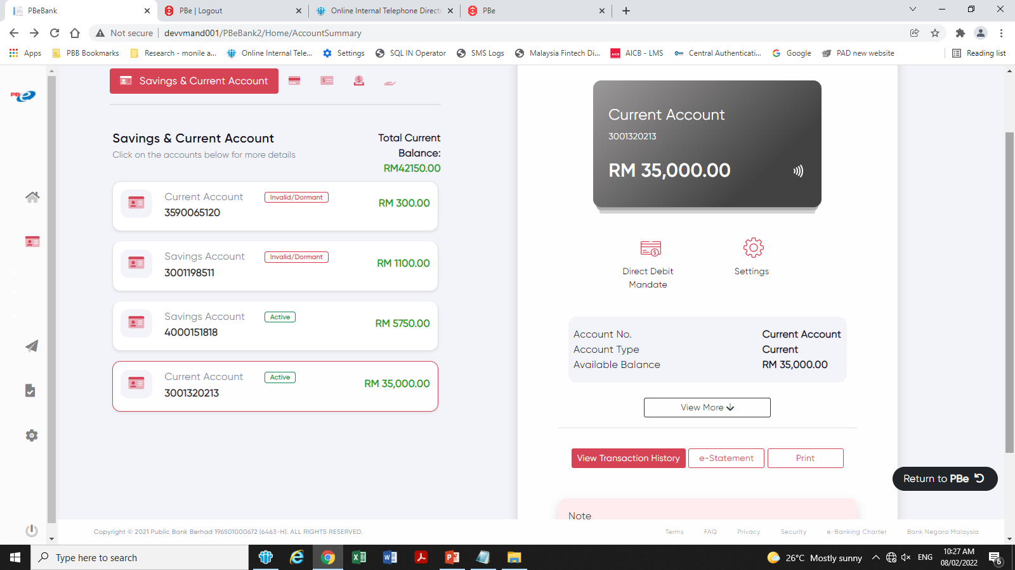


View E-Statement (in red colour)
View E-Statement

Slide 5
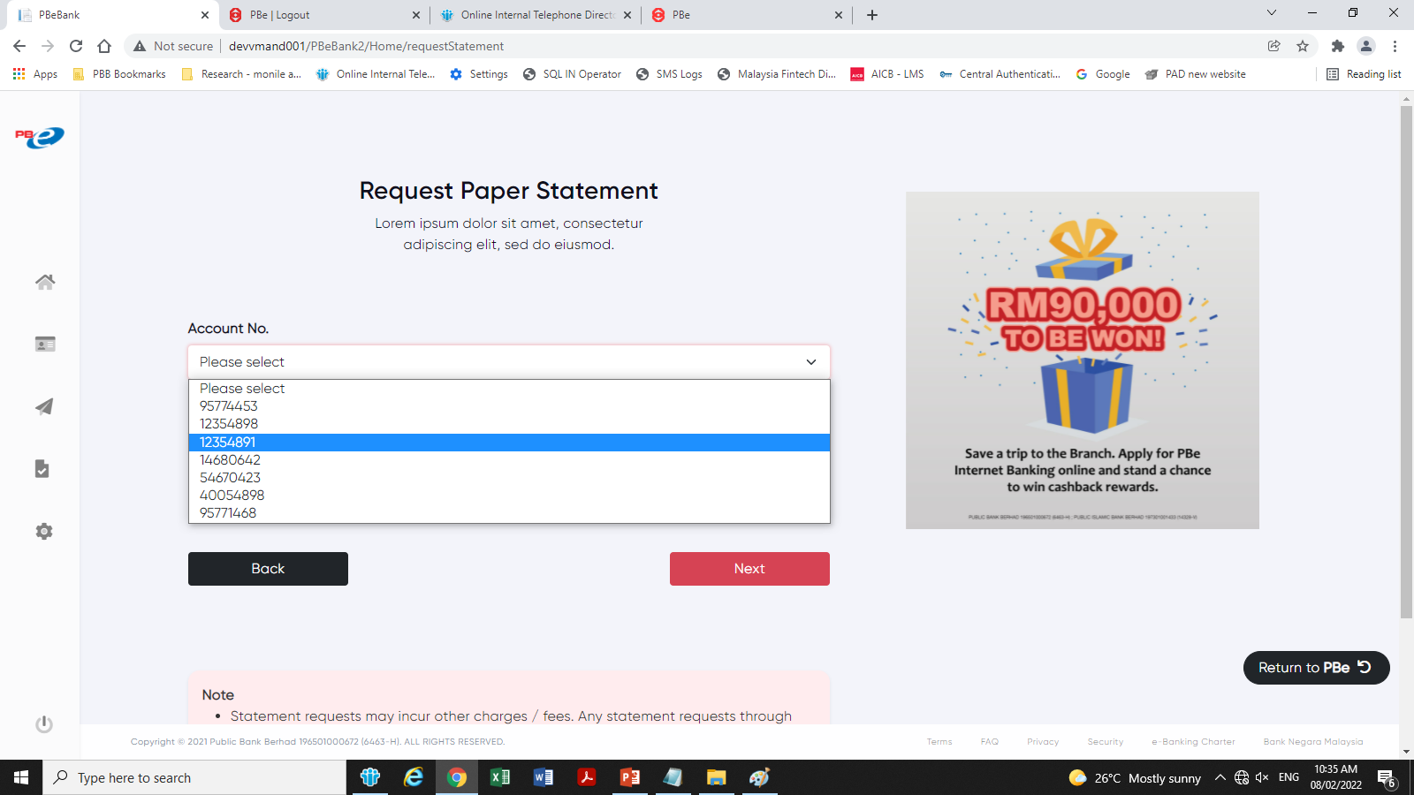
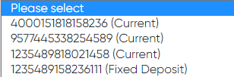
Pls display account type. Eg.
Add Clear buton

Slide 6
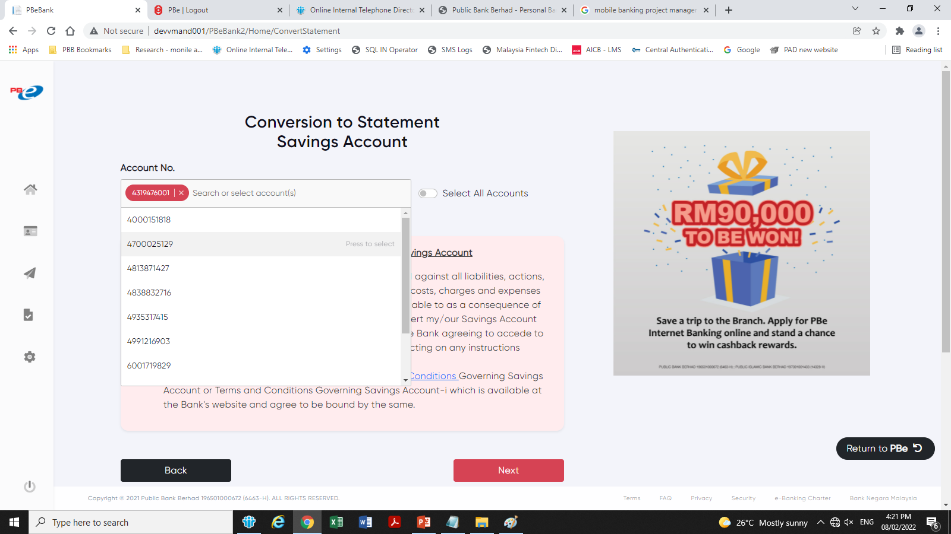
Pls display account type in the listing.
However, once the account is selected, the account type will not be shown at the above bar that highlighted in green
Add Clear buton

Slide 7
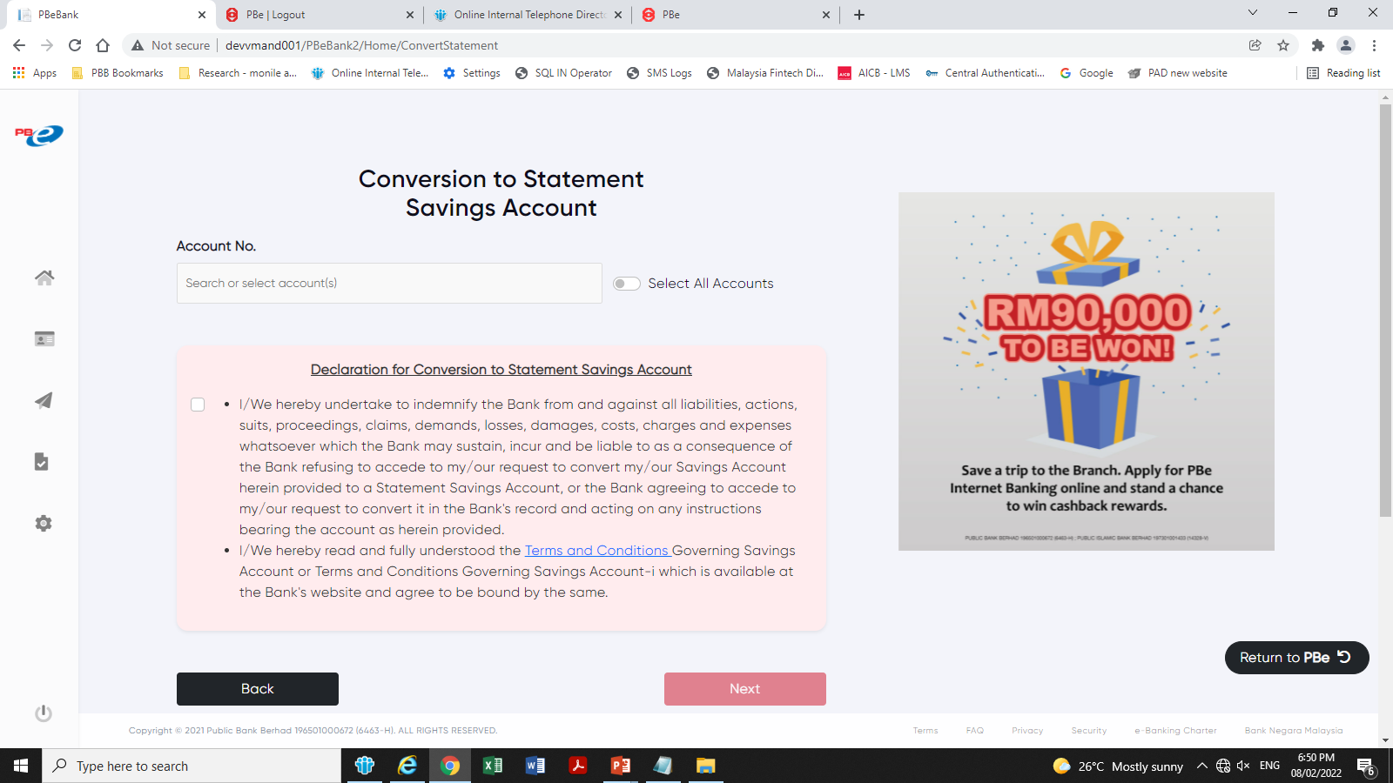
Remove the Declaration background colour.
Follow the UI for Balance Transfer screen.

Slide 8
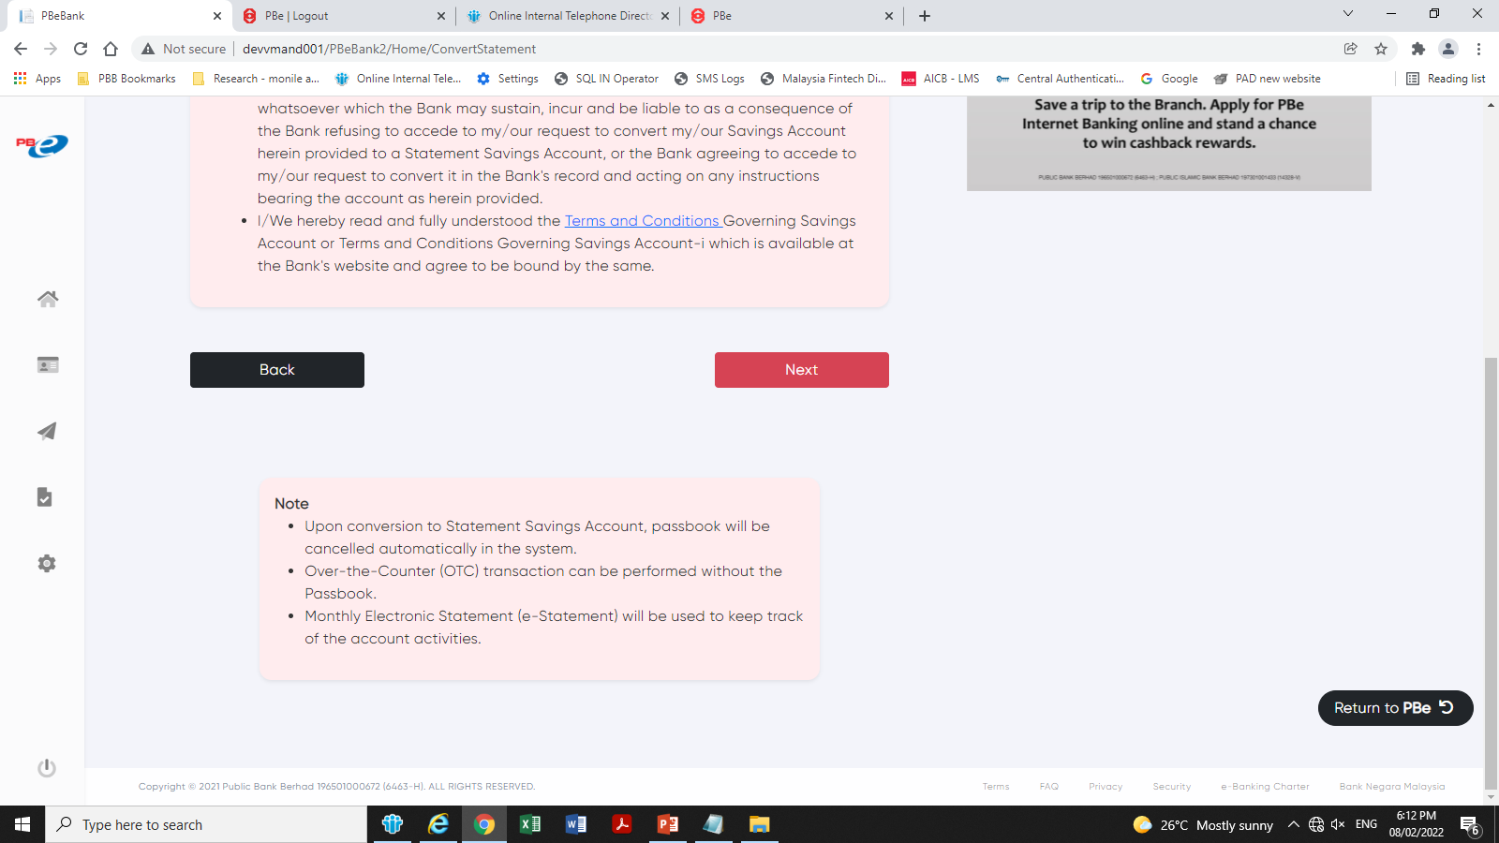
For standardization, to extend the width of the note

Slide 9
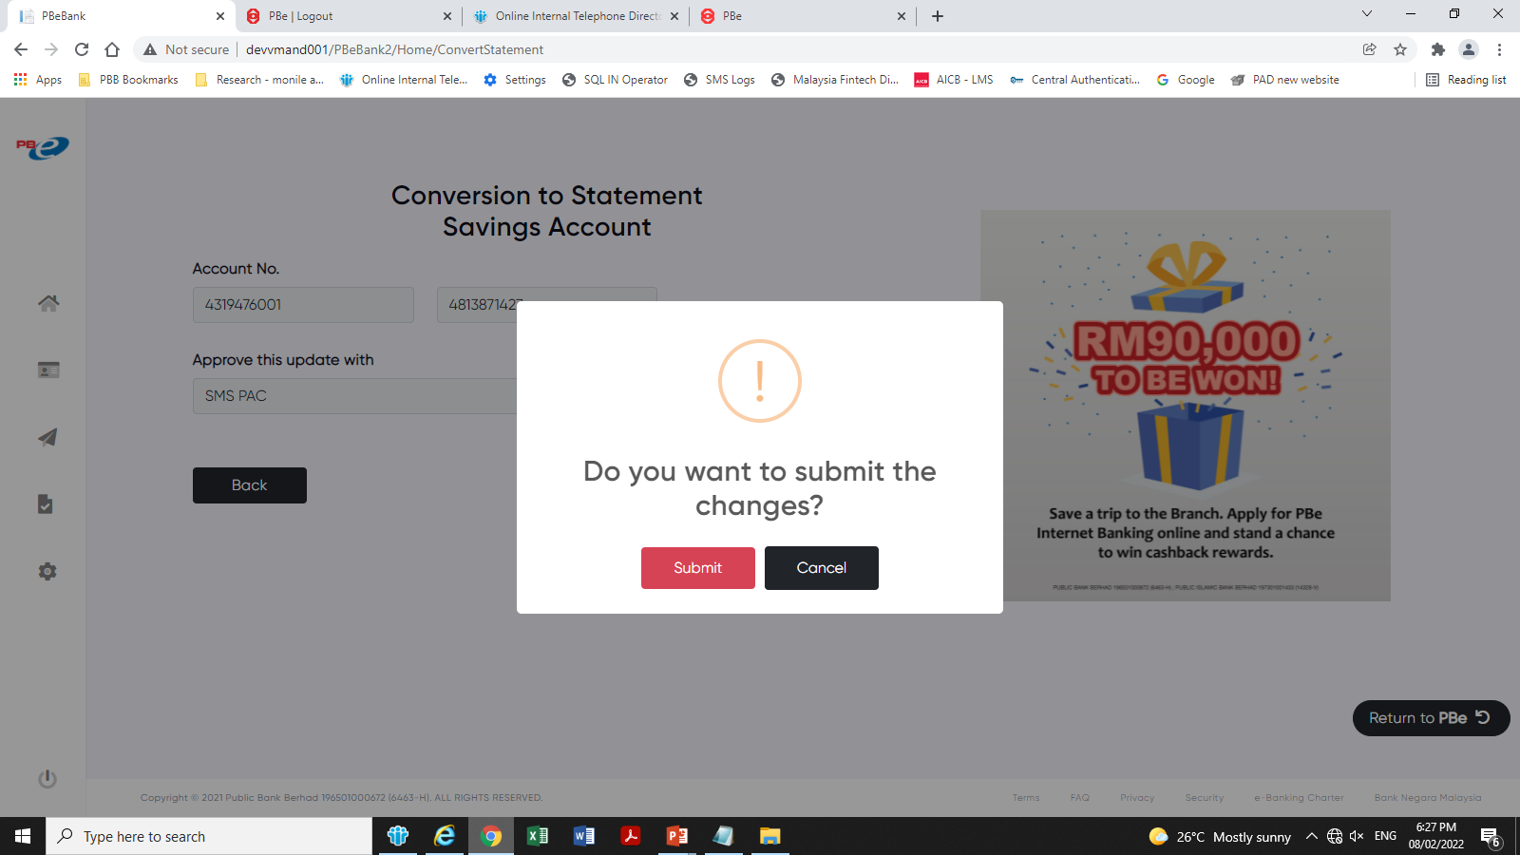
Remove this screen as the OTP is an act of authorization

Slide 10
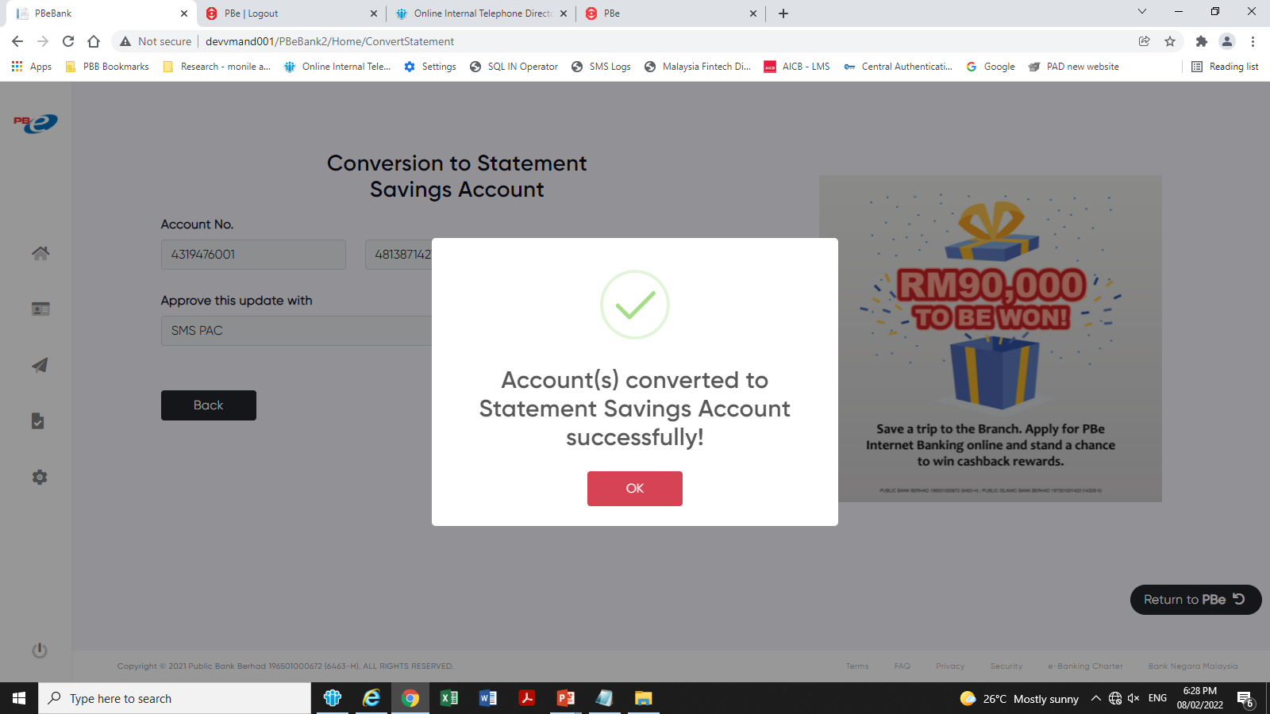
Remove this popup

Slide 11
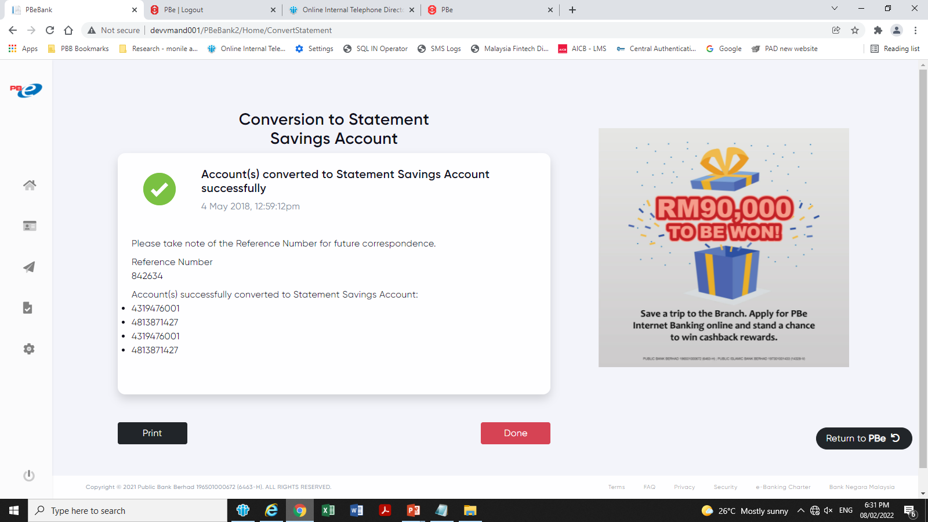
Add some spacing after the header
Account(s) Converted Successfully
Change to:
Reference No. 842634
Account No.(s) 4319476001
4813871427
4319476001
4813871427

